Slide 1
Time Randomization to Thwart Concurrency Bug Exploitation
David Tagatac, Michalis Polychronakis, Salvatore Stolfo
3/11/2015

Slide 2
Outline
Example Attack
Software Diversity
Time Randomization
Results

Slide 3
I. Example Attack

Slide 4
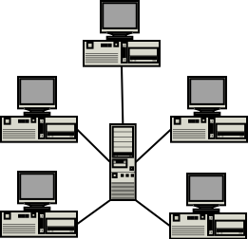
Example Attack: scenario

Slide 5
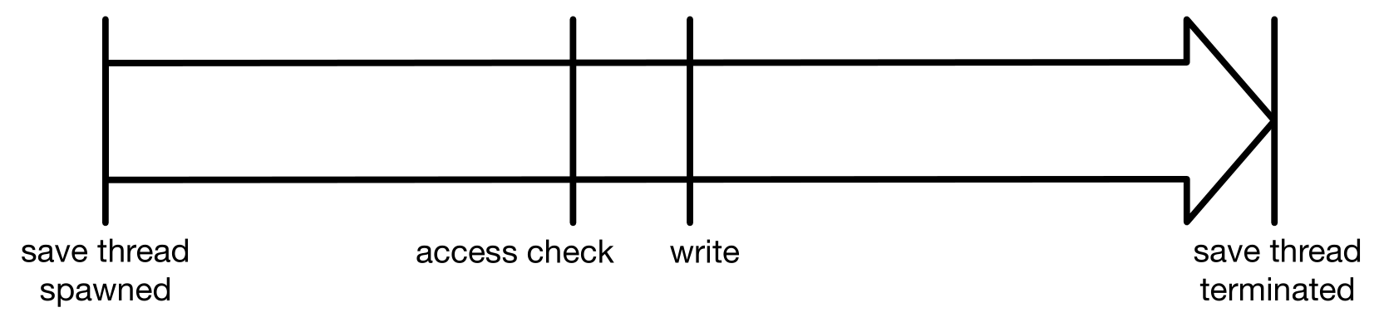
Example Attack: save operation

Slide 6
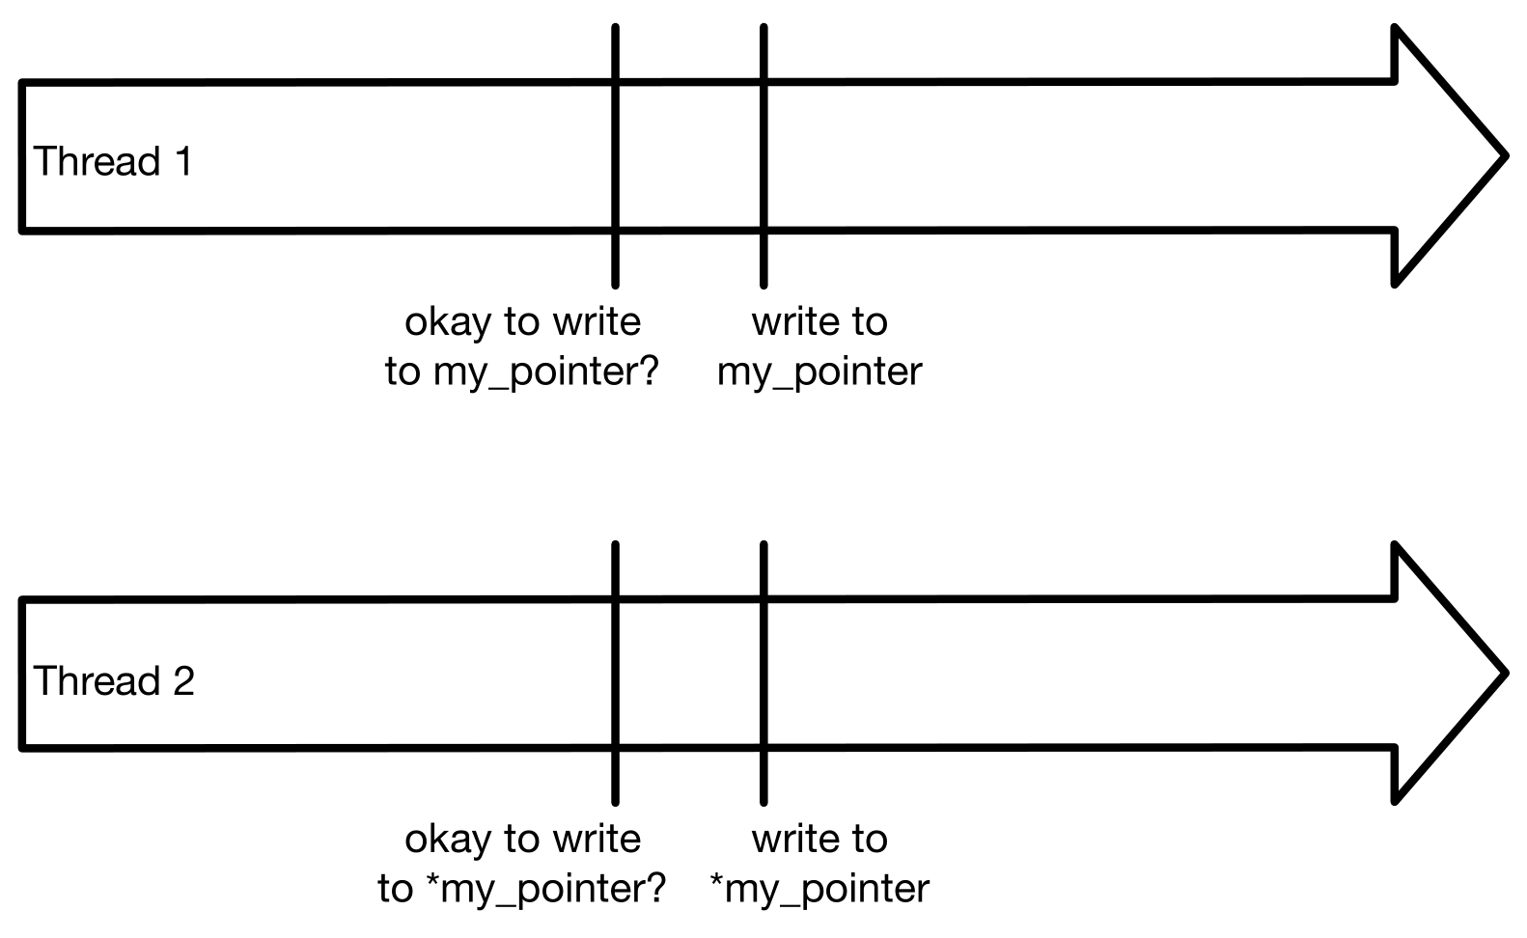
Example Attack: two threads

Slide 7
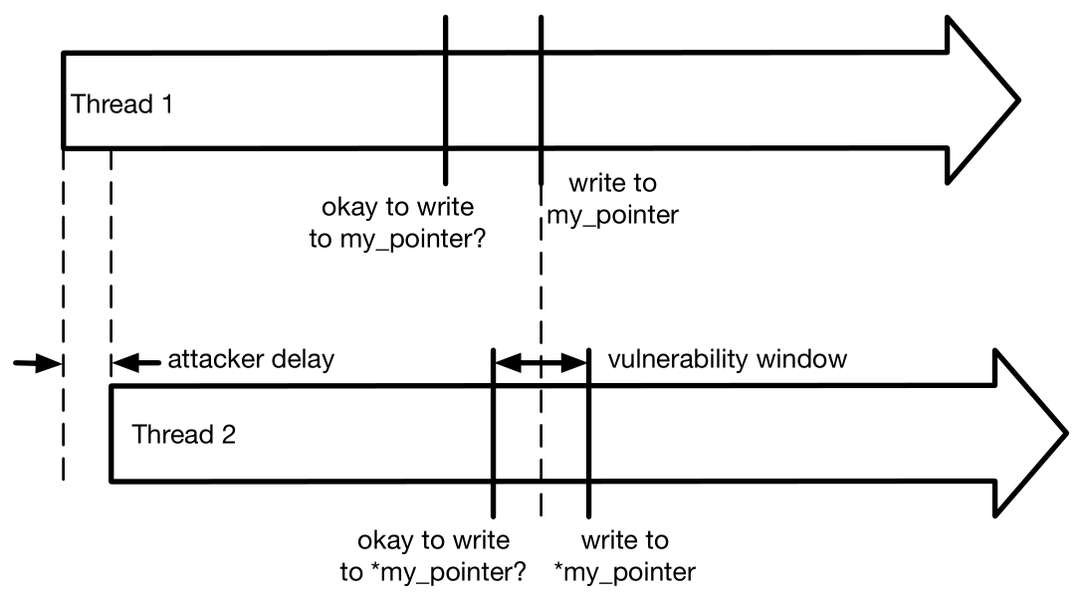
Example Attack: attack

Slide 8
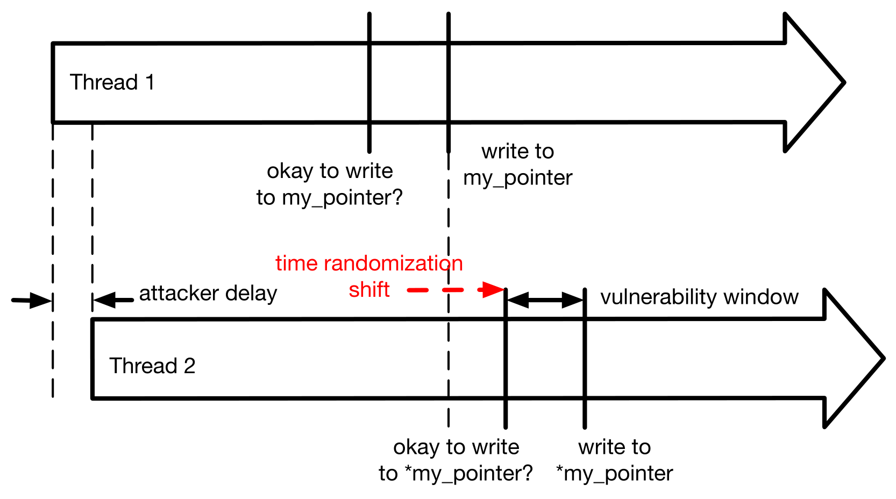
Example Attack: thwarted

Slide 9
II. Software Diversity

Slide 10
Software Diversity: dangers of a monoculture
GEER , D., BACE , R., GUTMANN , P., METZGER , P., PFLEEGER , C., QUARTERMAN , J., AND SCHNEIER , B. Cyber insecurity: The cost of monopoly. Computer and Communications Industry Association (CCIA), Sep 24 (2003).
“[Lack of software diversity is a threat to society.]”

Slide 11
Software Diversity: taxonomy
LARSEN , P., HOMESCU , A., BRUNTHALER , S., AND FRANZ, M. SoK : Automated Software Diversity. IEEE S&P (2014).
Instruction level
Basic block level
Loop level
Function level
e.g. stack layout randomization
Program level
e.g. ASLR
System level
e.g. system call mapping randomization

Slide 12
Software Diversity: taxonomy for concurrency
Add delays to a thread or threads
Reorder something such that thread interleaving is affected

Slide 13
III. Time Randomization

Slide 14
Time Randomization: library interposition
program
dynamic library
foo()
foo()
{
…
}

Slide 15
Time Randomization: library interposition (continued)
program
dynamic library
foo()
foo()
{
…
}
interposition code
foo()
{
<random-length NOP loop>
real_foo()
}

Slide 16
Time Randomization: three transformations
T1: all dynamic library functions
T2: library functions before syncs
T3: library functions after syncs
All three can be considered instruction-level transformations which add delays to threads.

Slide 17
IV. Results

Slide 18
Results: summary
Bug | Tranformation Applied | Time Randomization Effective?
Libsafe | T1 (all) | Yes
Libsafe | T2 (before syncs) | No
Libsafe | T3 (after syncs) | Yes
Libvirt | T2 (before syncs) | No
Libvirt | T3 (after syncs) | Yes
Canonical Atomicity Violation | T3 (after syncs) | No

Slide 19
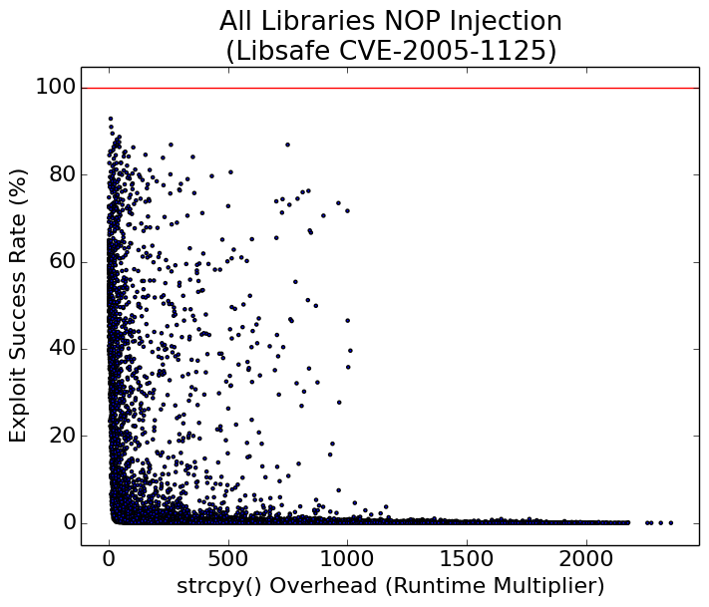
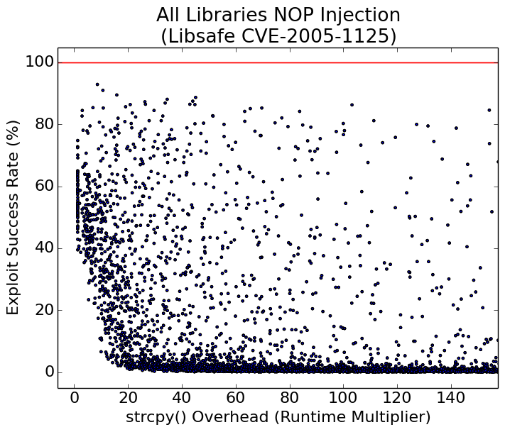
Results: T1 applied to Libsafe bug

Slide 20
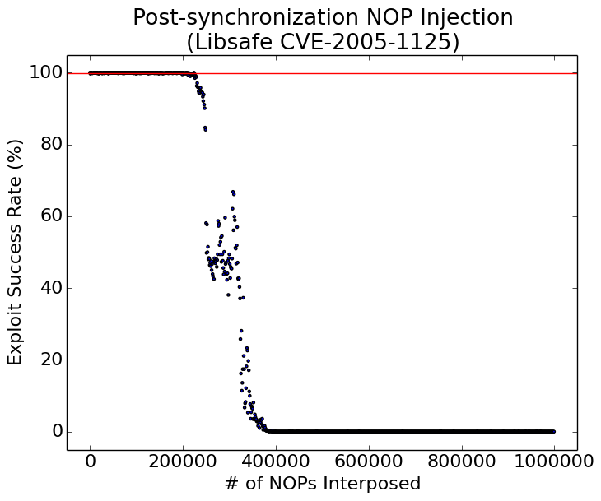
Results: T3 applied to Libsafe bug

Slide 21
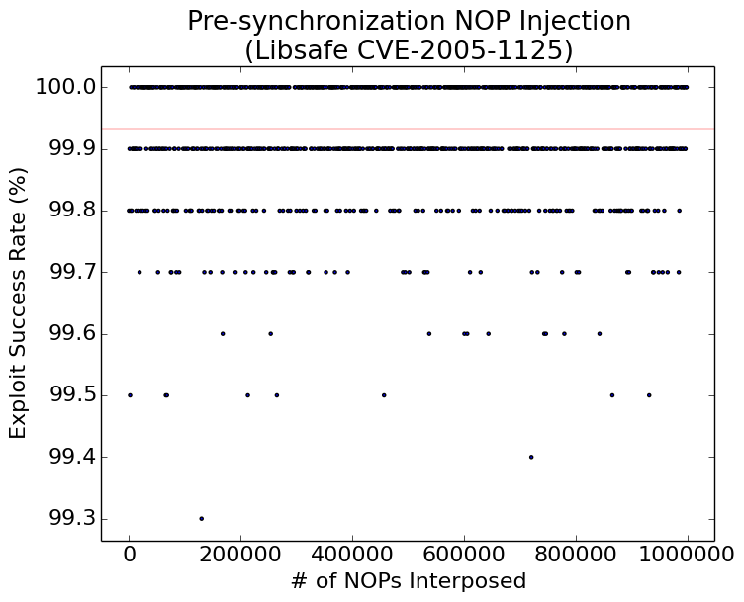
Results: T2 applied to Libsafe bug

Slide 22
Ask me stuff
gg

Slide 26
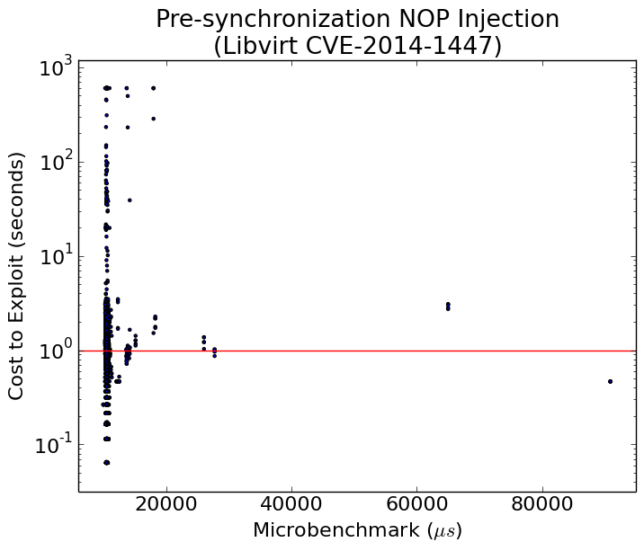
T2 applied to Libvirt bug

Slide 27
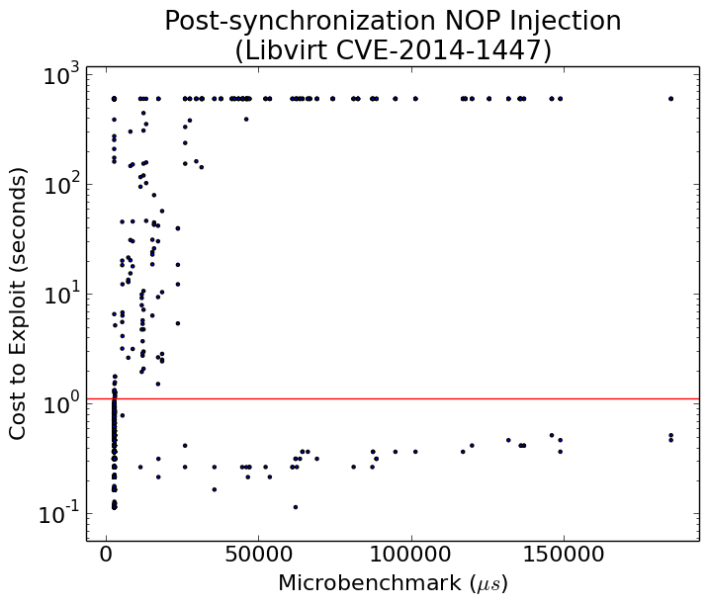
T3 applied to Libvirt bug

Slide 28
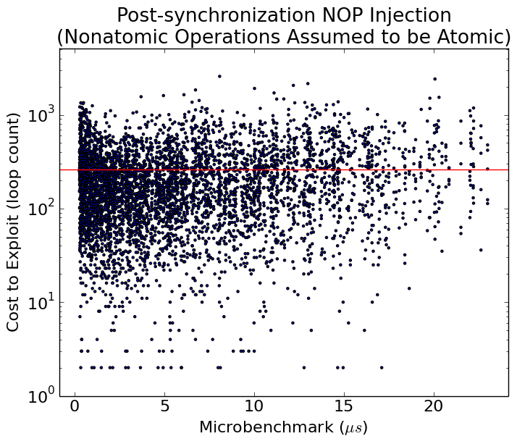
T3 applied to canonical atomicity violation bug

